Slide 1
Rat Legs: Optimal Distancing of A-Frames on Julius Cheezer from Dynamic Force Analysis
Brandon Lim
4/11/2024

Slide 2
Introduction
Brandon Lim | Dynamic Force Analysis of Julius Cheezer and its Effects on the A-Frame Support | 4/11/24
Goal of analysis
Find optimal distancing between A-Frame supports according to dynamic forces to achieve a factor of safety of 7
Approach
Calculate forces generated by vehicle motion
Calculate stresses in the A-Frame supports created by vehicles forces
Calculate the optimal distances between supports using the chosen factor of safety and stresses calculations

Slide 3
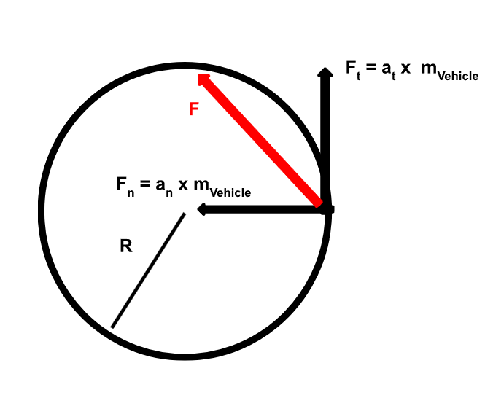
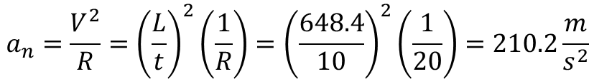

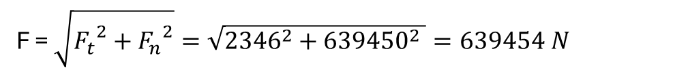
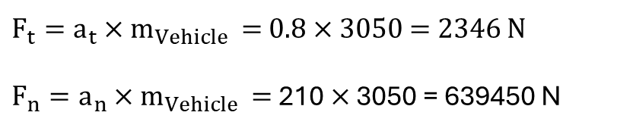
Force Calculation
Brandon Lim | Dynamic Force Analysis of Julius Cheezer and its Effects on the A-Frame Support | 4/11/24
From Centripetal Acceleration
$$a_{t}=\frac{V_{out}−Vin}{t}= \frac{54 −46}{10}=0.8\frac{m}{s^{2}}$$
$$a_{n}=\frac{V^{2}}{R}={\left(\frac{L}{t}\right)}^{2}\left(\frac{1}{R}\right)={\left(\frac{648.4}{10}\right)}^{2}\left(\frac{1}{20}\right)=210.2\frac{m}{s^{2}}$$
From Newtons Second Law
$F_{t}=a_{t}×m_{Vehicle }=$ 0.8 $×$ 3050 = 2346 N
$F_{n}=a_{n}×m_{Vehicle }=$210 $×$ 3050 = 639450 N
F = $\sqrt{{F_{t}}^{2}+{F_{n}}^{2}}=\sqrt{{2346}^{2}+{639450}^{2} }=639454 N$

Slide 4
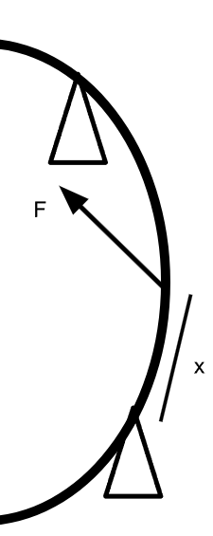
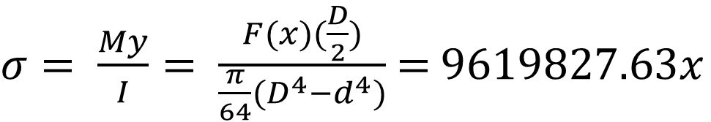

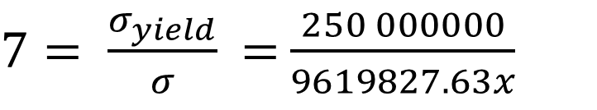
Stress and Distance Calculation
Brandon Lim | Dynamic Force Analysis of Julius Cheezer and its Effects on the A-Frame Support | 4/11/24
$σ= \frac{My}{I}= \frac{F(x)(\frac{D}{2})}{\frac{π}{64}(D^{4}−d^{4})}$ = $9619827.63x$
Factor of safety = 7
$7= \frac{σ_{yield}}{σ}$ = $\frac{250 000000}{9619827.63x}$
$$X=26 meters$$

Slide 5
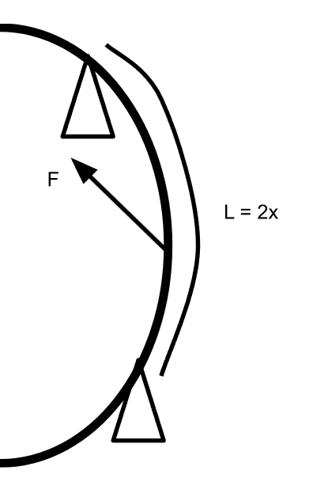
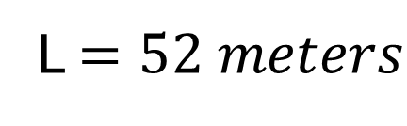
Results and Conclusion
Brandon Lim | Dynamic Force Analysis of Julius Cheezer and its Effects on the A-Frame Support | 4/11/24
$$X=26 meters$$
L $=52 meters$
Each A-Frame support should be spaced 52 meters apart on Julius Cheezer to achieve a factor of safety of 7

Slide 6
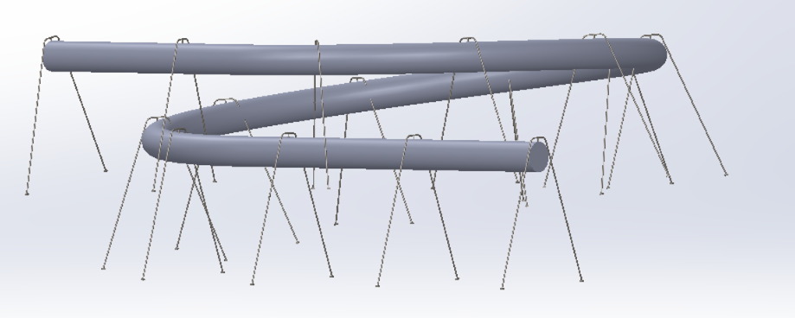
Q&A
Brandon Lim | Dynamic Force Analysis of Julius Cheezer and its Effects on the A-Frame Support | 4/11/24

